Slide 1

Text Summarization in Python
Notes:
Hello everyone, welcome to this new video in the series of videos in which we are talking about text summarization in Python. In this video, we are going to be looking at how to do text summarization in Python, using statistical technique. So, let's get started.

Slide 2
AGENDA
What is text Summarization?
Why text summarization should be used?
Use cases of text summarization
Methods of summarizing a text
Terminologies.
Let us implement our own text summarizer in Python
Methodology.
Pseudocode.
Task for you..
Notes:
on this slide, I talked about the agenda of the video. And when I talk about the 18 de my prime, prime motive is to actually tell you exactly what you can expect from the video so that you have an idea of the process that we are going to be taking in this particular video. Okay, so the first thing that I'm going to be talking about is what exactly is text summarization. Obviously, it's quite a trivial, because most of you watching this video might already be familiar with this particular field. But still, just for the sake of it, I go over this topic called what is text summarization. After that, I talked about why text summarization should be used. So there are many reason reasons to it, and we are going to be looking at exactly why do we use text summarization. Then I'm going to be talking about use cases of text summarization, and after that we will talk about two different methodologies, of summarizing a text. Now here, in this particular video we will implement one of those methodology, which is called statistical methodology based on word frequencies. Then I'm going to be talking about some of the terminologies that that I expect every one of you should be familiar with, before I actually start getting into the implementation process.
Then the implementation will be started in Python. First I am going to be talking about the methods methodology that we are going to be following, and we are going to be exactly laying out those steps that we need to follow to implement text summarization. And then in the next step, I will display a pseudocode to you so that you have an idea of how are we going to proceed and implement the algorithm that we discussed in the previous slide.
And finally, I will have a task for you, I will discuss few things that I feel, you should be able to do. So that is what we are going to be doing. After that, okay. So I hope you are excited as I am. Let us get started.

Slide 3
What is text summarization?
Text summarization is what its name suggests.
It is a technique in computer science to take a piece of text and return the desired length of text as a summary of the input text.
Notes:
Okay, so let us talk about what is text summarization. So, text summarization is what its name suggests, given a piece of text, given a piece of large text, we expect our machines or computers to take that text as an input, and we expect from our machine, another text.
Possibly the length of the output text would be, obviously, smaller, otherwise we wouldn't input that large text if the length of the output text would be just same as the input text. We want to summarize our text for that we would need a smaller text so that we can call that particular text summarization algorithm, efficient algorithm. So, it is a technique in computer science to take a piece of text, and return the desired length of text as a summary of input text. And here, here's the important part, we need to have the ability to specify the, the input of the desired length of the text that we want to get the summary of. Okay.
So let us now move on to the next slide.

Slide 4
Why
Why should we bother about text summarization?
We are constantly getting bombarded with the text information like never before. News articles, social media, books etc. How are we going to consume all of this in our limited 24 hours day?
Notes:
So now we will understand, why should we bother ourselves to learn about text summarization. Why do we have to learn text summarization
As you might be aware, you might be aware of the fact that constantly day by day, we are getting more and more information overload. Because the sources of information are just getting increased, day by day. So, in such a situation, it gets really difficult for us to analyze and read all the information sources in its entirety. So in those scenarios, when we don't have time to go over the whole text, we would like our machines are intelligent machines, computers, smartphones to give us a summarized version of that text. So this is the whole idea and that is why we study some text summarization.

Slide 5
Use Cases
TextRank like PageRank (by Google)
There is a news application called Inshorts which summarizes the news content like no one does. They use AI powered methods to accomplish such a feat.
Automatic Book summaries.
Automatic Script Summaries
And so on….
Notes:
Now let us talk about some of the use cases of text summarization. So there are in particular for use case that I want to discuss with you. The first one is, obviously, for summarizing news. And in fact, there is a application Android application, and in fact it's also. It also provides its application in the form of iOS. But let's say it's an Android application and what it does is it provides you news in the form of short summaries and it uses AI heavily in their applications of text summarization so what they do is this. They scrap news content from all over the internet and they summarize it in the form that will be digestible by the user. And that is how its name comes from. So it name. The name of this application is in shorts, because it is giving you the news in short summary. Okay. Now, another. Another use case is automatic Book Summaries, and automatic script summaries. And apart from that, there is an algorithm called PageRank by Google. Now what PageRank does is it takes all the keyword like whenever we search something on the, on the Google search. Then what it does is, it goes into its repository, and it searches for all the relevant matches, and it ranks. The, the relevant matches for that particular keyword and it ranks that particular keyword on top, similar to this PageRank algorithm. We have also got a text rank algorithm. Now, the idea behind text rank is similar to the PageRank algorithm. We have a corpus of text, what we do is we feed that corpus of text, or larger pile of text to this text rank algorithm. Now what this text, text rank algorithm will do is it will produce a summarized version in the way, because it is going to give us most important sentences in our keyword, and we will kind of implement a very simple version of text rank algorithm in this particular video. Okay. But there are many more such use cases of text summarization obviously we will not be able to talk, all of them in this video. So let us now move on to the next slide.

Slide 6
Methods of Summarizing text
Broadly, the methods of summarizing the text can be classified into following two types:
Traditional Statistical Approach (Word Freq - Sentence weight based).
Modern more powerful, Seq2Seq neural networks models.
Notes:
Now let us talk about two methods of summarizing text. In this video, obviously we will be using one of them, but there are actually two methods, and in fact, there might be other methods also, but as of now, we are going to be briefly discussing two of them. The first one is traditional statistical approach. And what this statistical approach does is it relies on word frequency and calculate the sentence importance in a particular text. So, the idea is pretty simple. We take our text we compute each words importance, and from that importance we compute each sentence importance. So what we are essentially trying to do is we are essentially trying to rank our sentences. So, that is what I discussed in the previous slide. So in the previous slide, what I discussed was, we have this thing called text rank, and in that we rank our text. So that is what we are precisely doing so based on the importance of the words that appear in a sentence, we sought the sentence in some order, and we choose the top most sentences, say for example I have a large pile of text, and if I want to get the summary, in 10 sentences, then I will choose the top 10 sentences with highest score. All right, so this is one of the methods of summarizing text, one of the limitation of this traditional statistical approach is this, that it will it will produce the sentences that will be an exact match, from the text. It is one of the limitations of this particular approach, but there are more sophisticated and more powerful and advanced approach using neural networks to train, what is known as seq2seq are sequence to sequence models. And the idea behind sequence to sequence models is pretty simple. You give this particular model, a sequence and it will produce another sequence. Okay, so they are also one of the powerful algorithms to kind of build text summarization systems, but they are not only used for text summarization they are also used for text translation. Okay, so, seq2seq or agender class of models, which can be utilized for many other tasks. Okay, so I hope you got the idea.

Slide 7
Some Terminologies
Tokenization
Word based
Sentence based
Web scraping
Text cleaning using Regular Expressions.
Stopwords.
And so on...
Notes:
Okay, now that we know two methods for doing text summarization. Now we will be talking about some terminologies that I feel you should know before we jump to the implementation part in the Python. So, the terminologies are as follows. The first terminology is tokenization. What do we mean by tokenization in its broadest sense tokenization is just a process of splitting the text in some pre specified format. And that pre specified file format can vary. It can be based on word, it can be based on sentences or it can be based on some punctuation. So what we are essentially doing is we are splitting the whole text. If it is word based, we are splitting the whole text into the words, so those words will be known as tokens. But if we are. If we are basing our decision of splitting on sentences, then we will be having each tokens as a full sentence. Okay, so this is the whole process of tokenization. The second thing that we need that you need to know is web scraping web scraping is one of the techniques by which we can get the data from web using tools like requesting to that particular URL, and then making the get request and then making then calling some function on the response that we get, and using some ways by which we can scrap that content. And then, we need to know about text cleaning using regular expressions, so regular expressions are are a set of tools to work with text, and they make it really easy for us to do, text matching. And then you also need to know about stop words, stop words in a text, are those words, which do not have any significance associated to its meaning. So let us say the word is, is in its particular sense. Do not does not contain any meaning it is just used to make the sentence complete in the medical sense. Okay, so I hope you got the idea.

Slide 8
Let us implement our own text summarizer in python

Slide 9
Methodology (Algorithm)
Take a piece of large text = t
Clean that text and get a new text = t’
Get individual words called words and individual called sentences from t’
Make a frequency dictionary using the words list.
Normalize the dictionary to get the weights in the range 0-1
Then, use the dictionary to give sentences_score to each of the sentences.
Finally, sort the sentences with the highest scores as the one which will appear first.
Notes:
Now let us talk about the algorithm or methodology that we are going to be using to implement our text summarization algorithm. Most of the things may be clear to you up till this point. So what we want to do is we want to first of all, take the input. And what is that input, the input will be a large piece of text, and we'll call that text St. Then after that, what we do is we clean that text and cleaning itself will involve various other tasks, but that I will show you in the lab, when I will go to the lab environment, but for the time being, we will assume that everybody is aware of how to clean the text, and once we have cleaned the text we will get another text and that text will be represented by, let's say t dash. And once we get that t dash, what we will do is we will tokenize that text using words, as well as sentences. So we are using both the tokenization methods, we are using the tokenization method based on words, as well as sentences in this manner we will have to list Python lists, and those two lists will hold individual words and individual sentences respectively.
In the fourth step, what I'm going to do is I'm going to take that word list, and I'm going to make a frequency dictionary. So essentially what I'm trying to do is, I'm trying to create a key value pair where key will be a word and value will be the frequency of that word in the text. Okay, once we get that we will normalize that dictionary to get the words in the range of zero to one, why because normalizing is always considered good in the field of AI any statistical analysis. So what we have done here is we have just divided all the values by the maximum value so that none of the values can exceed one. Okay. Then finally we will compute what is known as sentences. And how are we going to compute that. So now that we have a frequency dictionary, we have we have a weight dictionary and from that weight dictionary we can get access of any words weight. Okay. And we can know what is the importance of that particular weight. So, earlier if you remember we had a sentences list, which contains a list of sentences from that text, and what we will do is we will score, each sentence based on that weight dictionary, and we will give a score higher the score, the more important that sentence will be okay. And then finally, we'll sort that sentences, according to sentence score to get top most a certain number of sentences, let us say we have decided that we want to get top 10 scores. Top 10 sentences with highest score. So, we will choose that according to. Okay, so I hope you got the point.

Slide 10
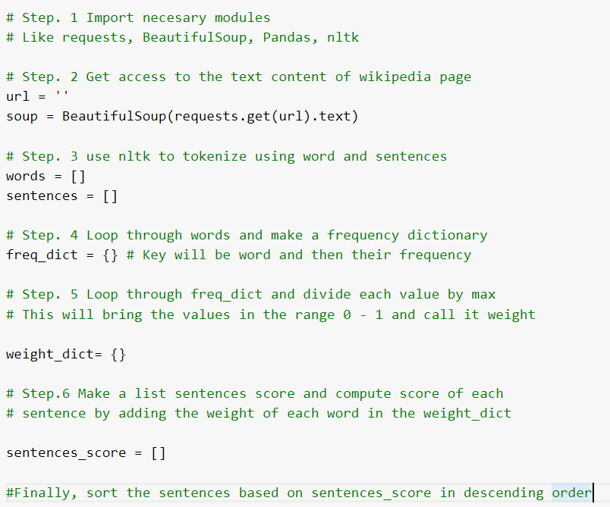
Pseudocode
Notes:
on this slide. What I have done is I have just translated the methodology that we discussed in the previous slide, to a working algorithm or working pseudocode that we are going to be just implementing in the Python. So, this, this particular pseudocode lists all the steps that needs to be taken to implement this particular algorithm. So if you look at the pseudocode, then you will realize that it has got six steps in the first step we import all the necessary modules which consists of request beautifulsoup pandas and NLT k, then we will be getting the access to the text content of Wikipedia page via text, or other web scraping which I discussed earlier. And then we will be using NLT K to tokenize words and sentences, which I have just discussed in the previous slide. And then we will be looping through the words and making a frequency dictionary now this frequency dictionary which is represented by Freek date. This will essentially hold all the key value pair, where key will represent the word and value will represent the corresponding frequency. Okay. And in this step five what we will do is we will just normalize it, and we will call the new dictionary as a dictionary, and using this weight dictionary we can get access of any words weight, and that way it will give us the information about that words important importance in that whole corpus of text, and from that importance by adding that those importance for each sentences we can compute sentences is score. And finally we can sort these sentences are to come up with top sentences in this particular text.

Slide 11
What can you do?
I have just touched the tip of the iceberg. The field of text summarization is vast. So, if you are interested, then you have plenty of things to explore. One of things that I would recommend you personally is to explore Seq2Seq models for text summarization as they have been proven to produce wonderful results.
The other things that you can do is to try to improve the text summarizer that I have implemented in this hands on tutorial. See, what is it that can be improve about this summarizer.
Notes:
Alright, now that we have implemented our whole algorithm, and now that we know we have a well working algorithm for doing text summarization. I want to share a few things few words to you and also few things that you might try on your own. The first thing is, first of all, you need to understand, I have just touched it, the tip of the iceberg. What does that mean that means I have not gone through all of the various aspects that go into text summarization. This is a very vast field, and you if you're really interested then you can you can find many things that will keep you engaged in this particular topic. So the first thing that I personally would recommend you is to explore seek to seek models, they are really wonderful. Because what I have done in this video is just implemented a statistical based novel frequency and word frequency based summarization, but if you, if you can learn sequence seek to seek models, then they will they will be a wonderful tool in your tool bag to do text summarization. Okay. And further, the next task, I want to give you, is try to you know come up with a better way of doing text summarization then I have done, try to see if you can improve anything, try to see if I have done something in not so sophisticated manner and if you get, if you can turn that into something really wonderful, then that would be really good. Okay, so I hope you got the point, and I hope you were able to understand everything that I have discussed in this particular video. Thank you so much.

Slide 12
Thank you

